Slide 1


Slide 2
Team Members
Arjun J
1
Arun Kumar m
2
Arun Kumar p
3
Ashikprakash
4

Slide 3


Slide 4
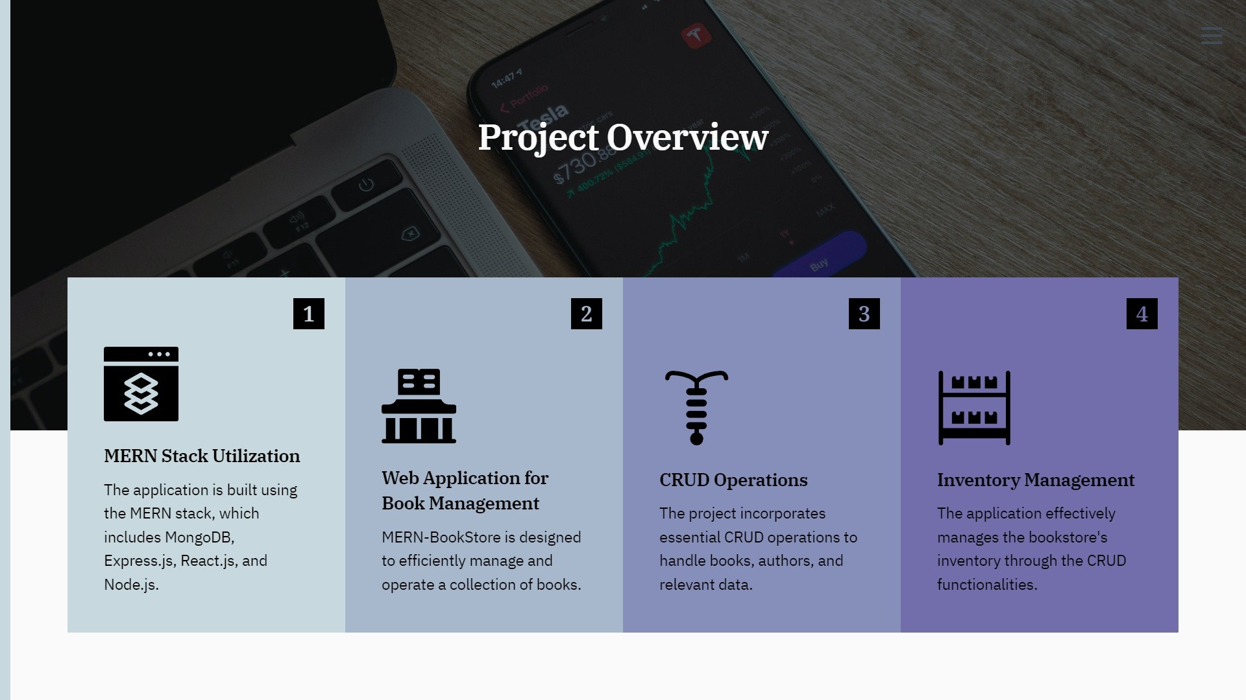

Slide 5
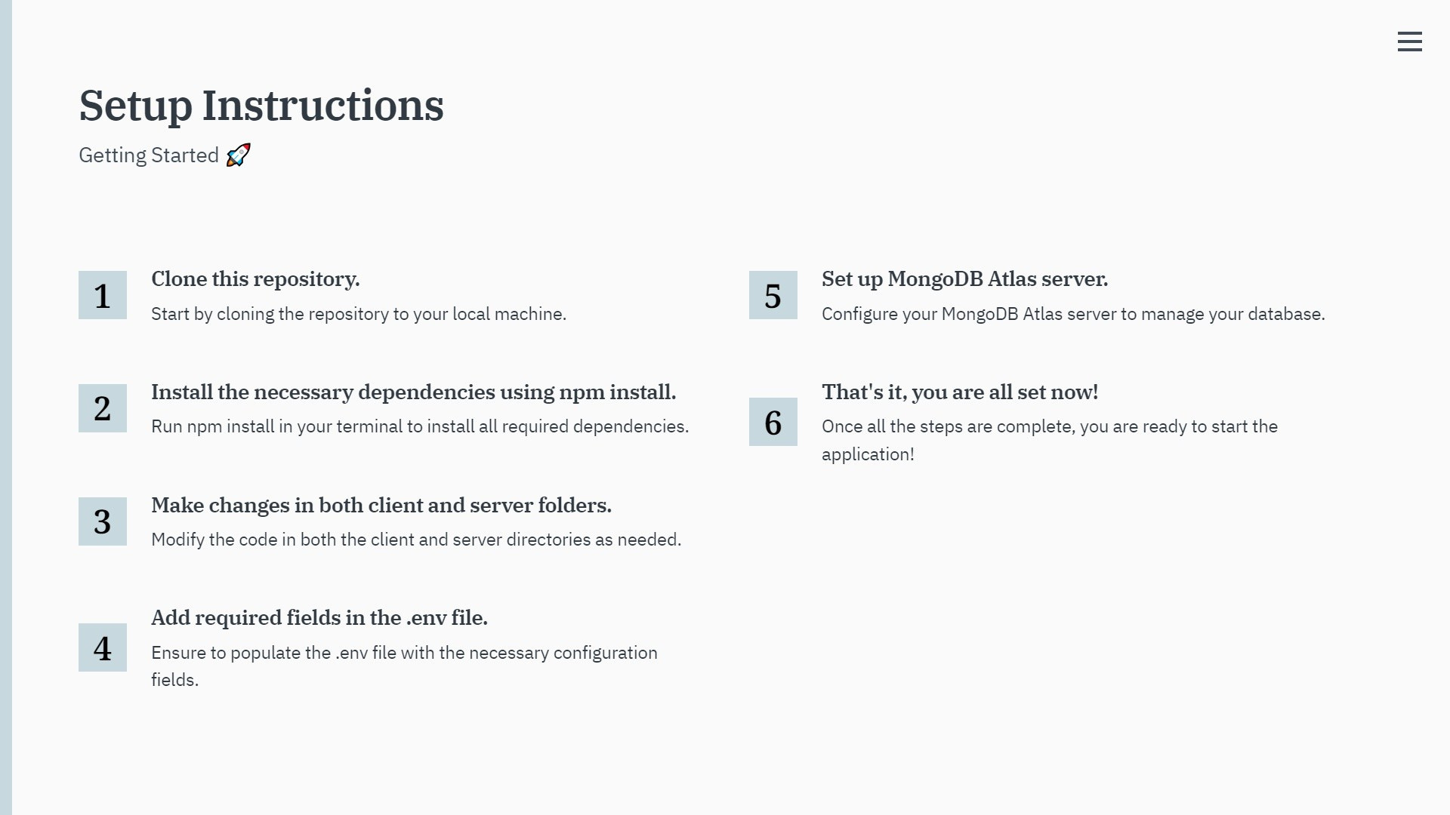

Slide 6
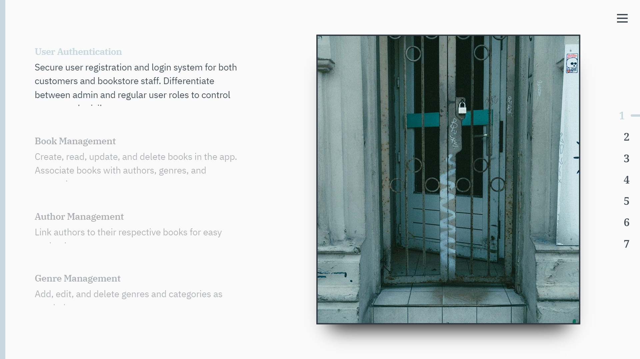

Slide 7
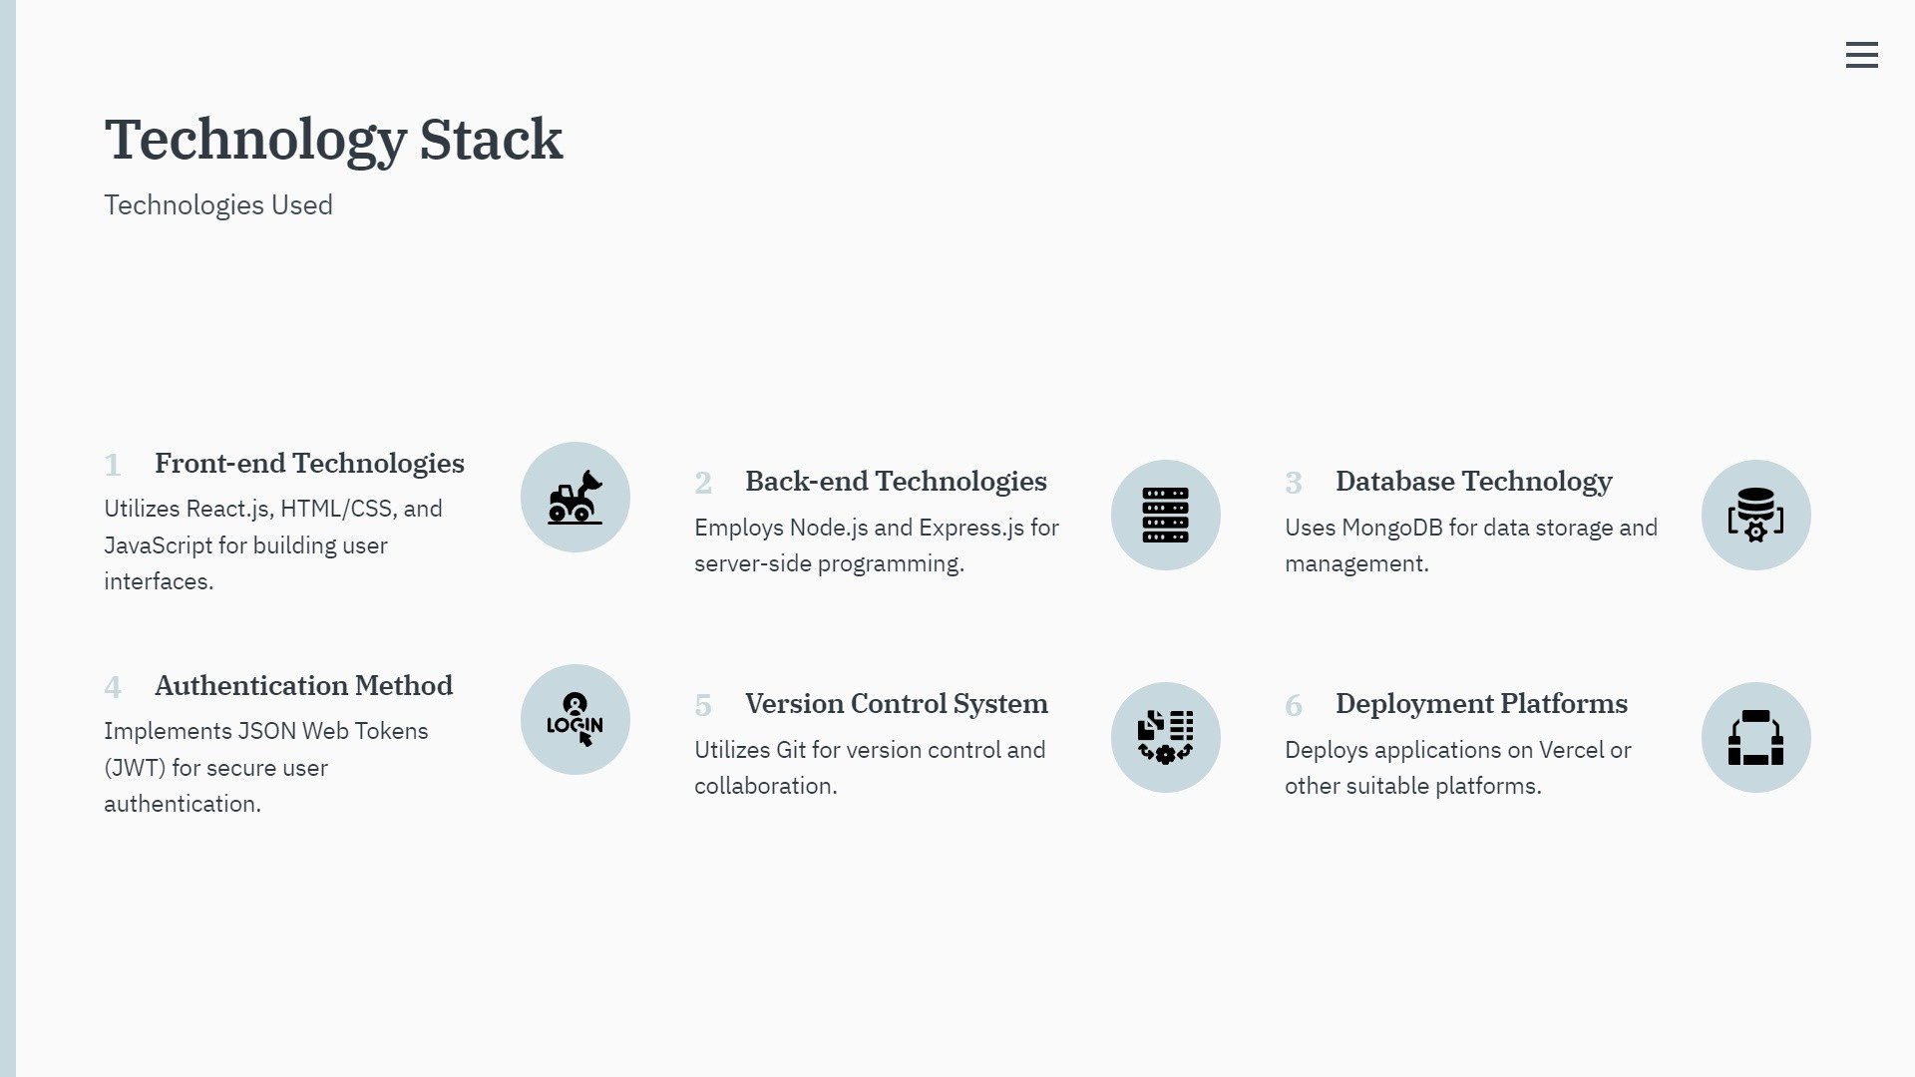

Slide 8
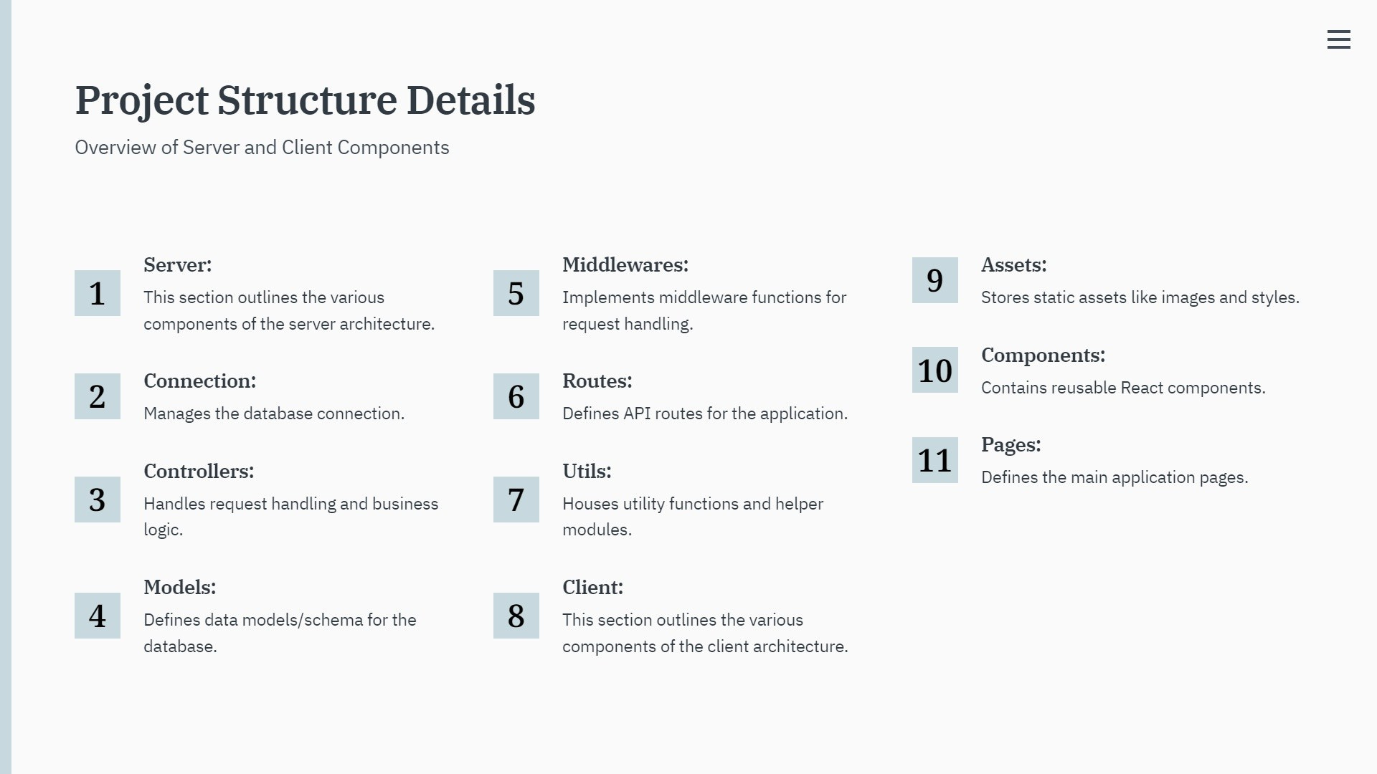

Slide 9
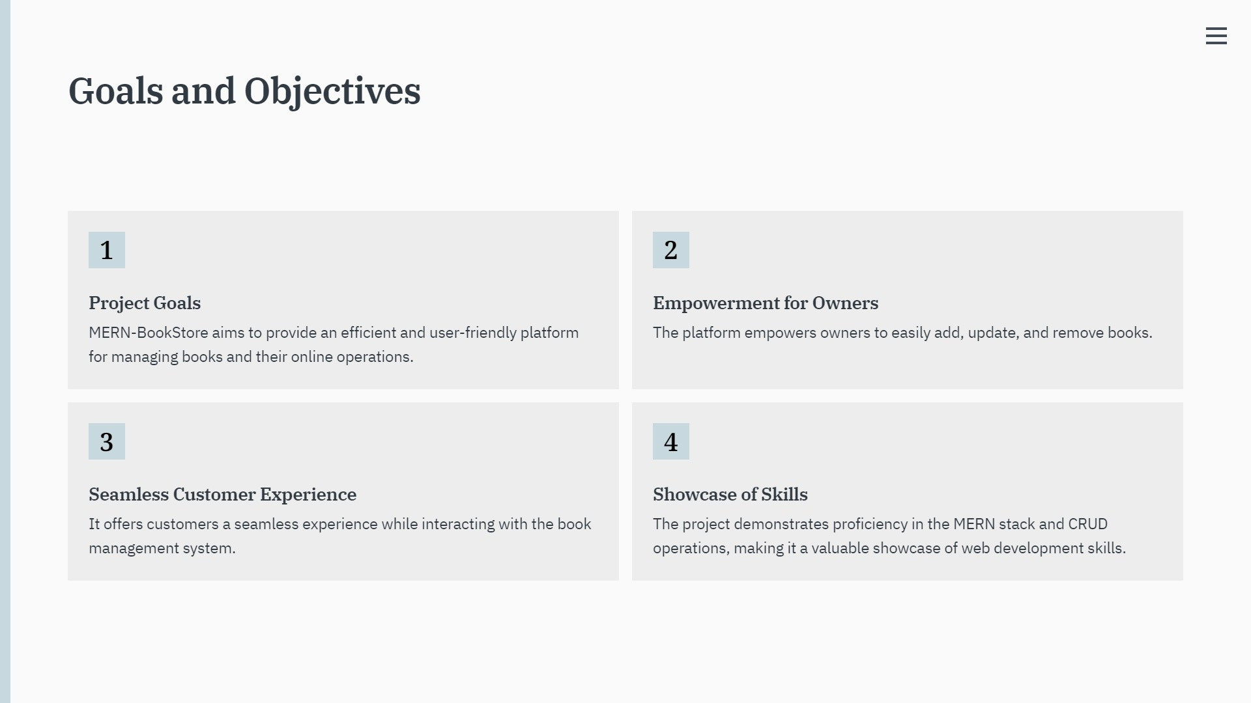

Slide 10
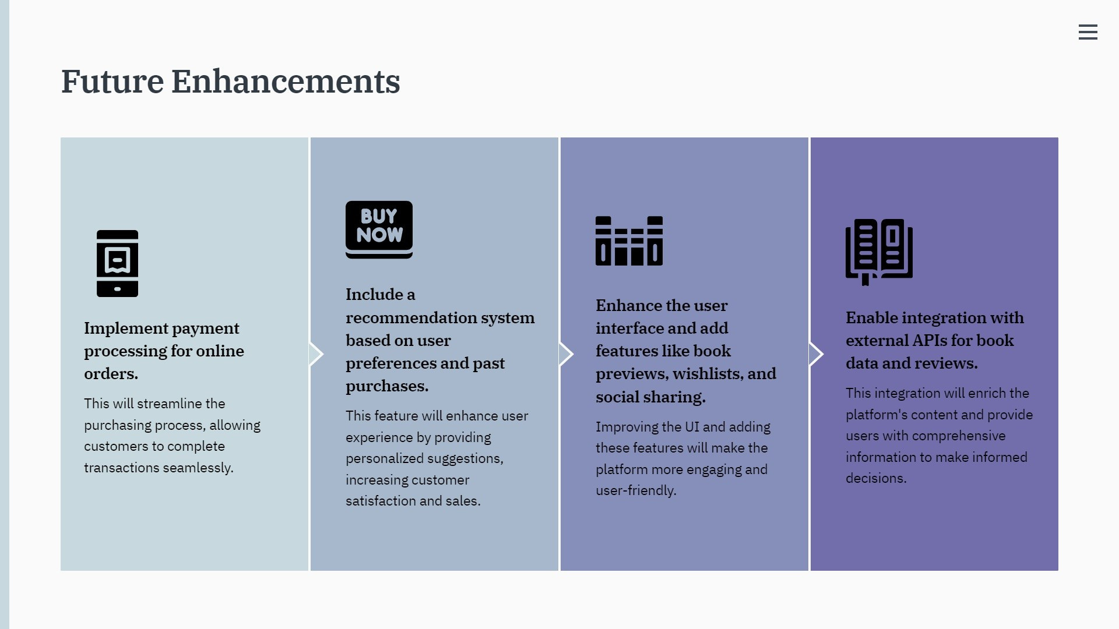

Slide 11


Slide 12
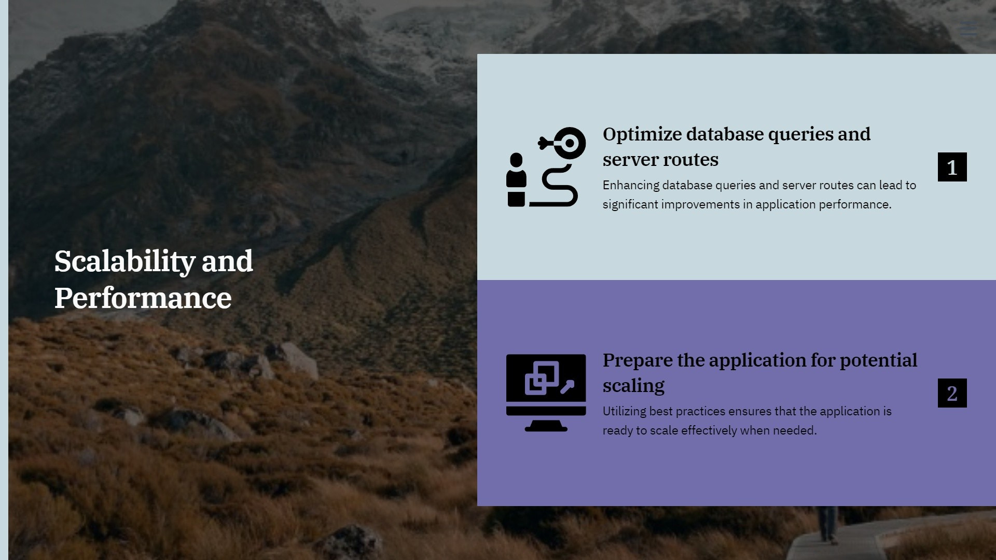

Slide 13
Thank You

